Slide 1

M.Sc. AIML & Data Science Semester – VIII CC-416: PROJECT-III: Project
Group | 28
Roll No. | 2
Name | Charchil Singh
Title | Movie Recommender
Under the Guidance of Dr. Ravi Gor
Department of AIML & Data Science School of Emerging Science & Technology Gujarat University

Slide 2
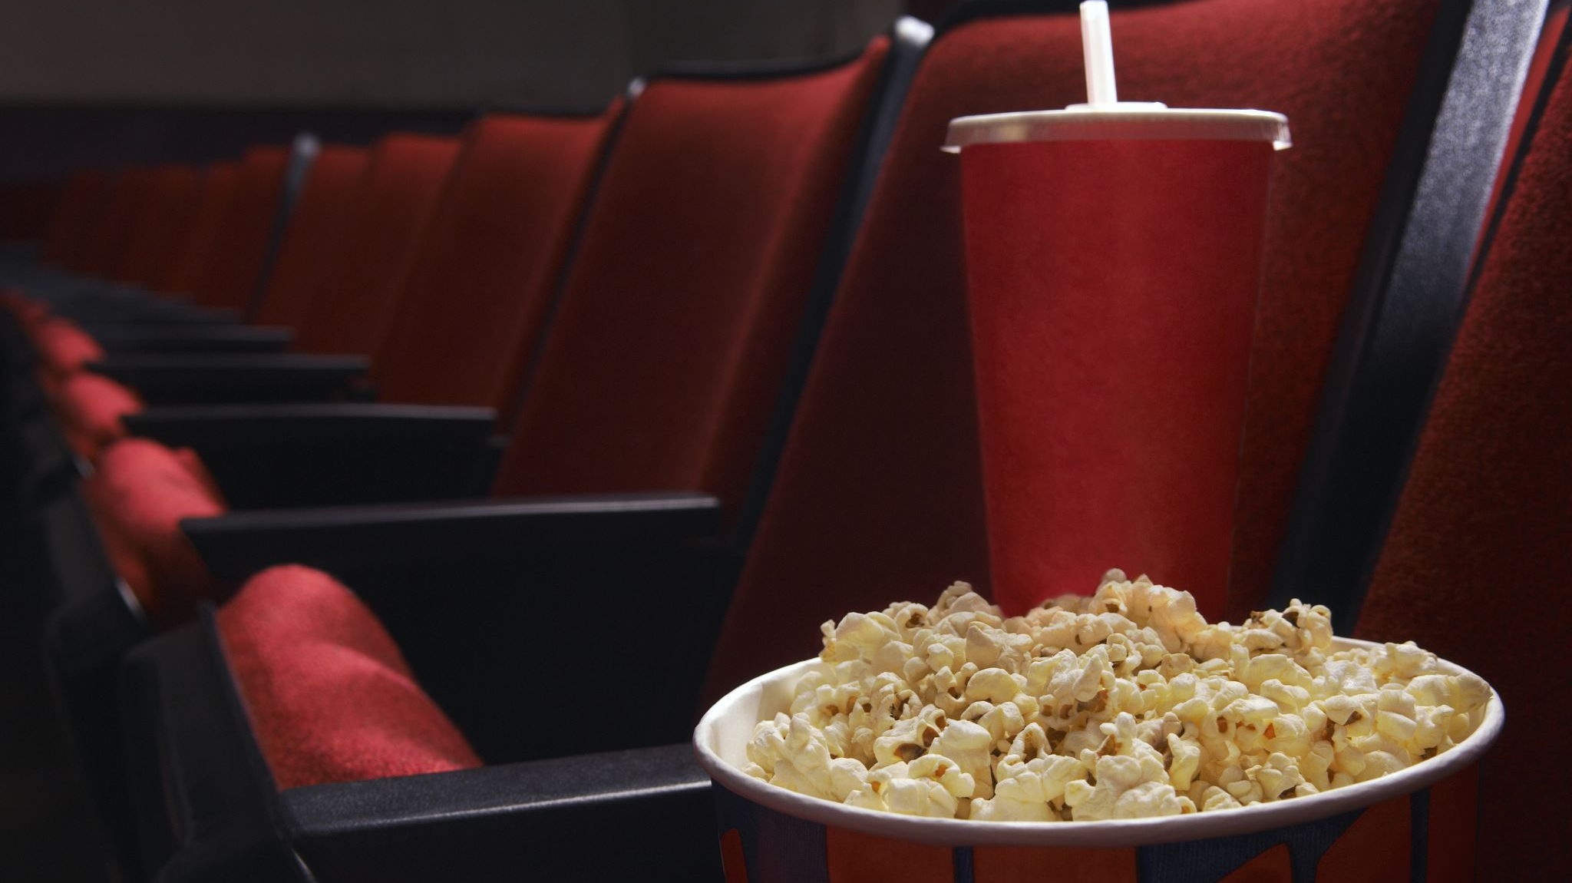
Movie Recommender System
By Charchil Singh
Data science
Roll no : 2

Slide 3
Introduction
Recommendation System is a filtration program whose prime goal is to predict the “rating” or “preference” of a user towards a domain-specific item or item. In our case, this domain-specific item is a movie, therefore the main focus of our recommendation system is to filter and predict only those movies which a user would prefer given some data about the user him or herself.
Recommender systems encompass a class of techniques and algorithms that can suggest “relevant” items to users. They predict future behavior based on past data through a multitude of techniques including matrix factorization.

Slide 4
Why Do We Need Recommender Systems?
We now live in what some call the “era of abundance”. For any given product, there are sometimes thousands of options to choose from. Think of the examples above: streaming videos, social networking, online shopping; the list goes on. Recommender systems help to personalize a platform and help the user find something they like.
The easiest and simplest way to do this is to recommend the most popular items. However, to really enhance the user experience through personalized recommendations, we need dedicated recommender systems.
From a business standpoint, the more relevant products a user finds on the platform, the higher their engagement. This often results in increased revenue for the platform itself. Various sources say that as much as 35–40% of tech giants’ revenue comes from recommendations alone.

Slide 5
workflow of recommender system
M.Sc. AIML & Data Science Semester – VIII CC-416: PROJECT-III: Project
Insert Movie Data set
Extract Important features
Create Tags of imp features
Recommend 5 movies with most similarities
Calculate the Cosine Similarity between vectors & Find 5 nearest vectors
Convert the Tags into Vector using BOW (Bag of Words)

Slide 6
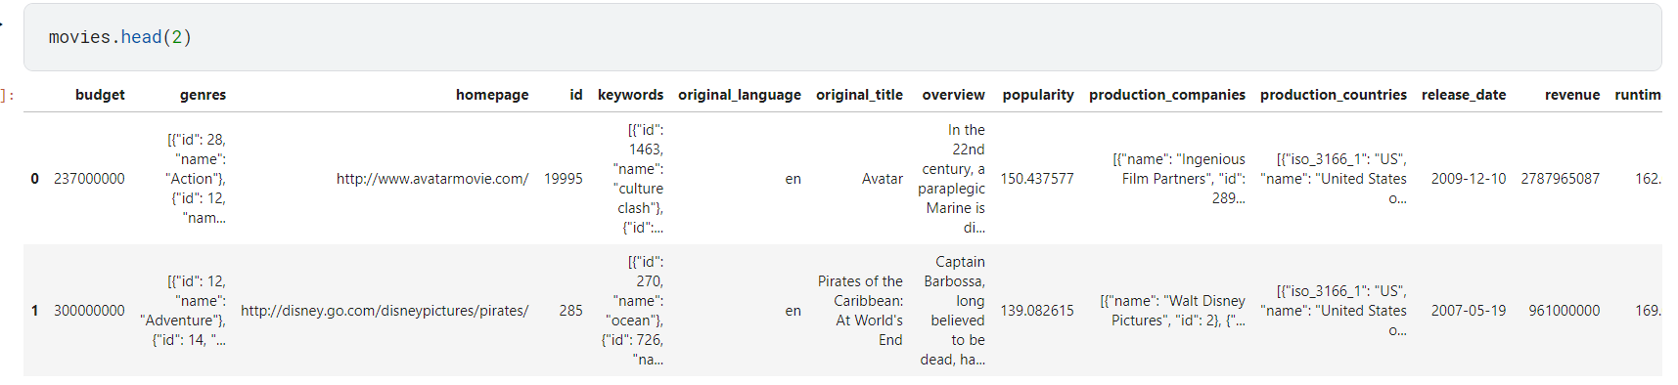
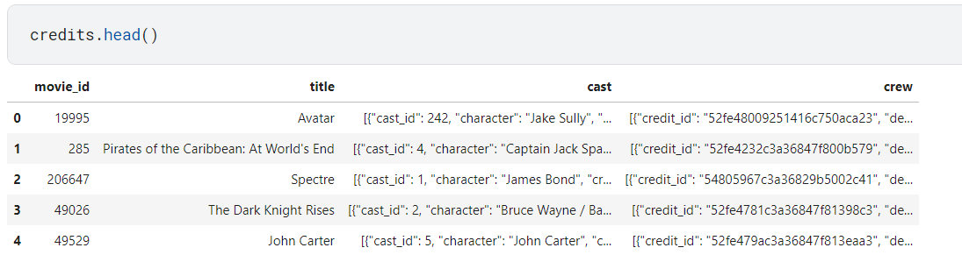
Data set

Slide 7
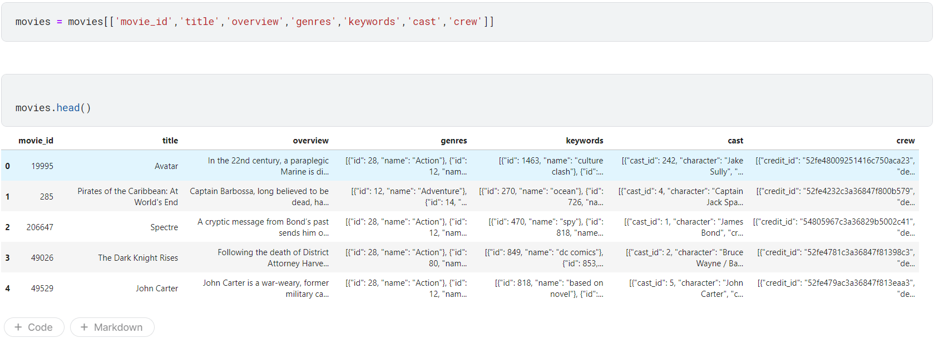
Important features

Slide 8
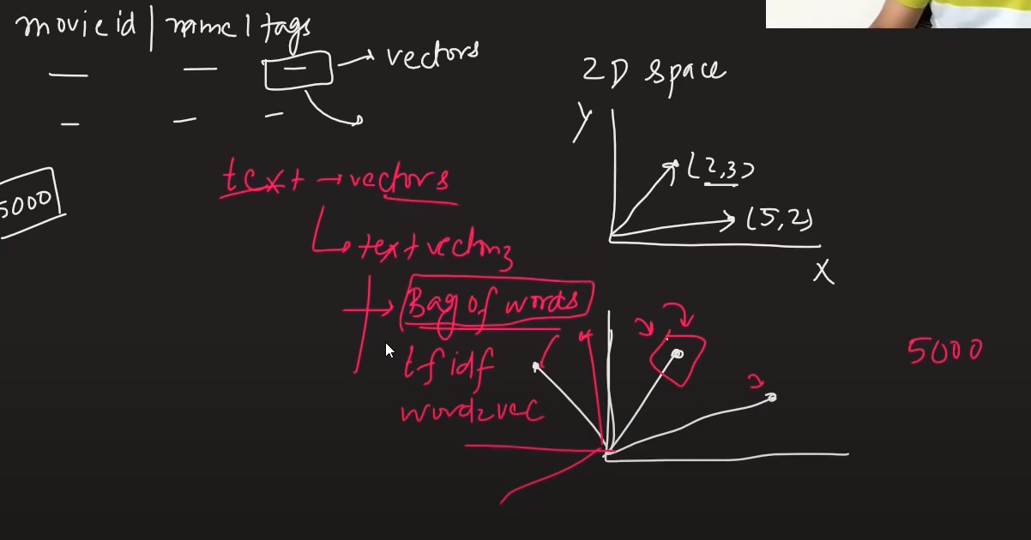
MEthodology

Slide 9
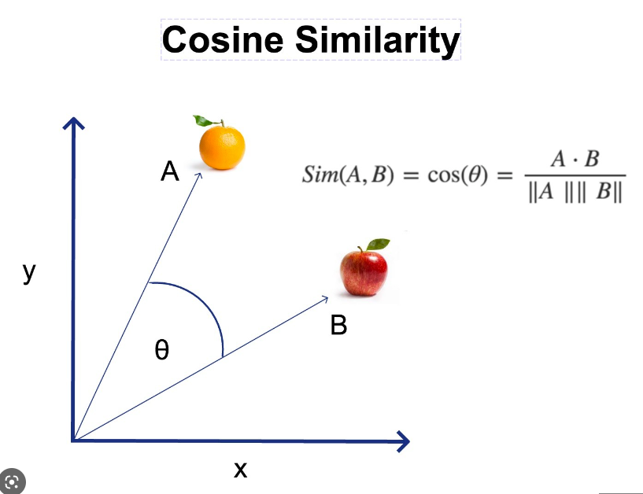
Cosine similarity
The movies are recommended based on a simple algorithm called Cosine Similarity. Cosine similarity is a measure used to determine the similarity between two items. Mathematically it can be determined as the cosine angle between two vectors in a three-dimensional plane. We can also check the Euclidean distance between the two vectors to determine how different or similar they are from each other. In our case, one of the vectors is the movie that is searched and the rest of the movies in the database are checked as the second vector. The top ten movies which have the least Euclidean distance corresponding to the searched movie are shown as recommendations.

Slide 10
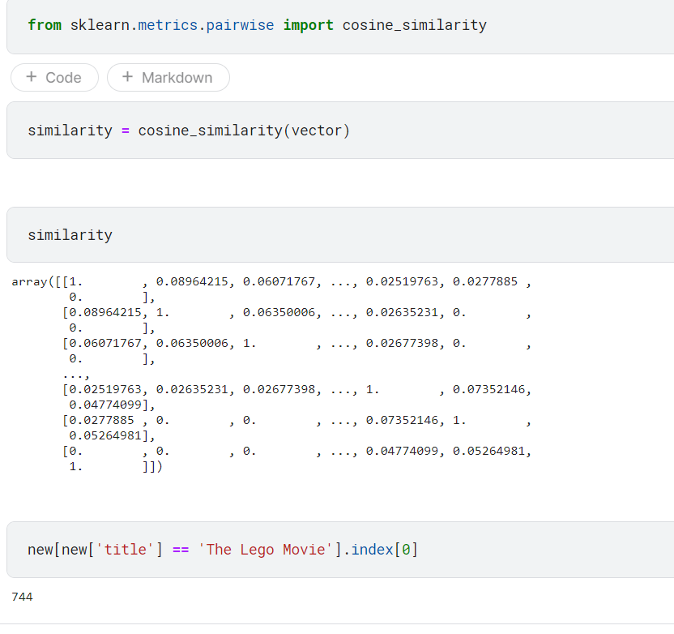
Finding similarity

Slide 11
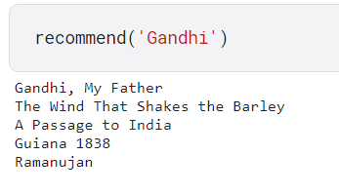
Result

Slide 12
Conclusion
We have illustrated the modelling of a movie recommendation system by making the use of content-based filtering in the movie recommendation system. The KNN algorithm is implemented in this model along with the principle of cosine similarity as it gives more accuracy than the other distance metrics and the complexity is comparatively low too Recommendations systems have become the most essential fount of a relevant and reliable source of information in the world of internet. Simple ones consider one or a few parameters while the more complex ones make use of moreparameters to filter the results and make it more user friendly. With the inclusion of advanced deep learning and other filtering techniques like collaborative filtering and hybrid filtering a strong movie recommendation system can be built. This can be a major step towards the further development of this model as it will not only become more efficient to use but also increase the business value even
further.

Slide 13
Refrences
https://www.themoviedb.org/login
https://www.machinelearningplus.com/nlp/cosinesimilarityhttps://www.youtube.com/live/A_78fGgQMjM?feature=share
https://www.kaggle.com/datasets/tmdb/tmdb-movie-metadata
https://www.ijeat.org/wp-content/uploads/papers/v9i5/E9666069520.pdf
https://ijisrt.com/assets/upload/files/IJISRT22APR1053_(1).pdf
https://www.youtube.com/watch?v=1xtrIEwY_zY&t=4457s

Slide 14

Thank You

